Slide 1

UWB-based audio guide for the visually impaired
Presented By: Aditya Kumar, Jeevan Reji
CS 8803 - MCI

Slide 2
Motivation
Empowering Accessibility
Challenges Faced by the Visually Impaired
Navigating unfamiliar indoor environments like museums, airports, or galleries is challenging without tactile or auditory cues.
Reliance on external assistance often limits independence and confidence.
Limitations of Existing Solutions
Current audio navigation aids often depend on Wi-Fi or Bluetooth, which can be inaccurate in terms of positioning.
Many systems lack real-time responsiveness or detailed location-specific information.
Significance of UWB Technology
Ultra-Wideband (UWB) provides precise indoor positioning with centimeter-level accuracy.
It enables real-time location tracking, making it ideal for guiding individuals in complex indoor layouts.
Empowering Accessibility:
Enhances autonomy for the visually impaired by providing clear, location-based audio guidance.
Creates inclusive spaces, allowing visually impaired individuals to explore and experience environments independently.
Potential Impact:
Reduces dependency on others for navigation.
Encourages equal access to cultural, educational, and public spaces.
Accessibility is not a privilege; it’s a human right!!

Slide 3
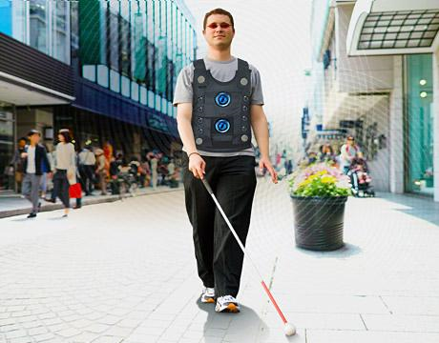
Objectives
Location-Specific Audio Cues
Provide clear and context-aware audio guidance based on the user’s position and movement.
System Usability
Design an intuitive interface requiring minimal user input for seamless operation.
Adaptability to Diverse Environments
Ensure the system functions effectively in spaces like museums, airports, and shopping malls.
Enhanced Accessibility
Prioritize inclusivity, catering specifically to the needs of visually impaired users.

Slide 4
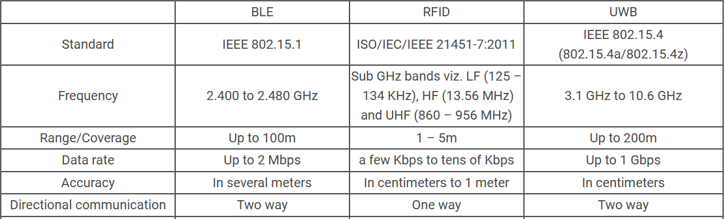
Literature Survey/ Background
Navigation challenges for visually impaired and elderly people in unfamiliar indoor environments.
Limitations of GPS indoors.
Existing solutions like RFID (Radio Frequency Identification) often suffer from issues such as accuracy, interference, and scalability.
Current System: RFID-based framework with wearable modules that interact with installed tags.
Obstacle avoidance categorized as expected/unexpected, mobile/fixed.
Limitations of RFID:
Accuracy limited to meter-level.
Prone to interference from environmental factors.
Scalability issues in environments with many users or tags.

Slide 5
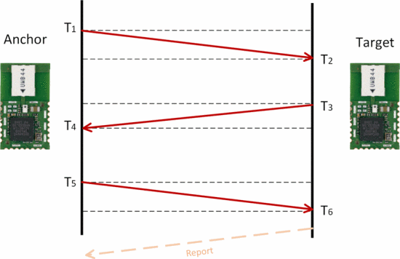
Methodology
Step 1: Setup and Components
UWB Devices
Multiple UWB Responders placed strategically in the environment, each assigned a unique Device ID.
An Initiator integrated with the user’s hearing device to interact with Responders.
Step 2: Localization Process
Signal Exchange
Initiator periodically sends signals to all nearby Responders.
Responders reply with their unique IDs and location data.
Nearest Responder Identification:
Distance to each Responder is calculated using Time of Flight (ToF) or Time Difference of Arrival (TDoA).
Responder with the shortest distance is selected as the nearest point.

Slide 6
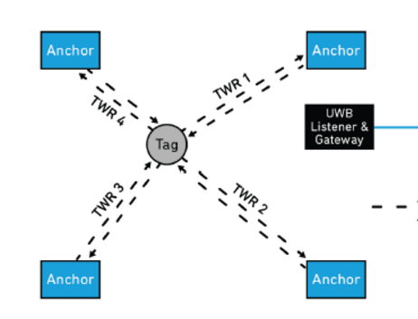
Methodology (Continued…)
Step 3: Audio Cue Delivery
The system maps the user’s location based on the nearest Responder’s ID.
Coded Audio Signal:
A location-specific audio message is triggered and played through the hearing device, providing real-time guidance.
Step 4: Continuous Updates
As the user moves, the system dynamically re-evaluates and selects the nearest Responder.
Ensures real-time, adaptive navigation assistance.
* Initiator: Tag * Responder: Anchor

Slide 7
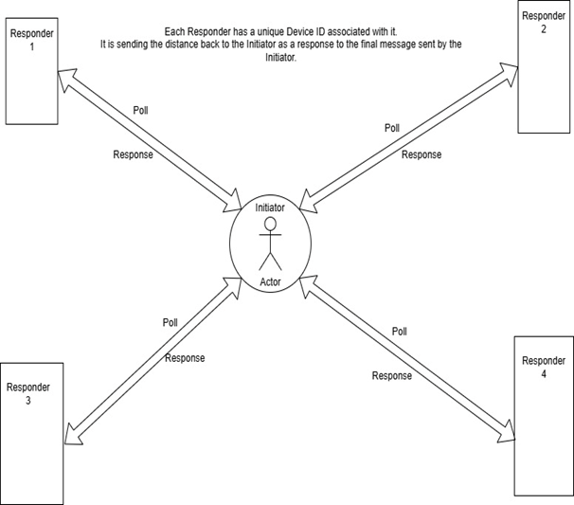
Practical Setup

Slide 8
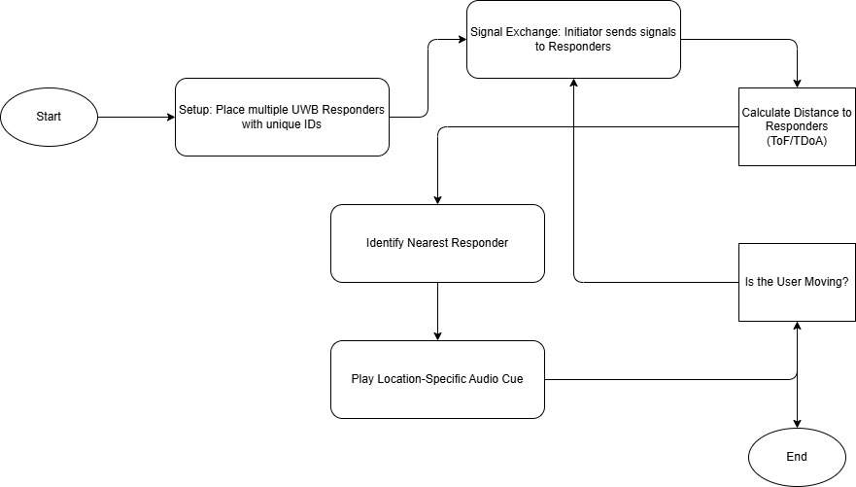
Flow Design

Slide 9
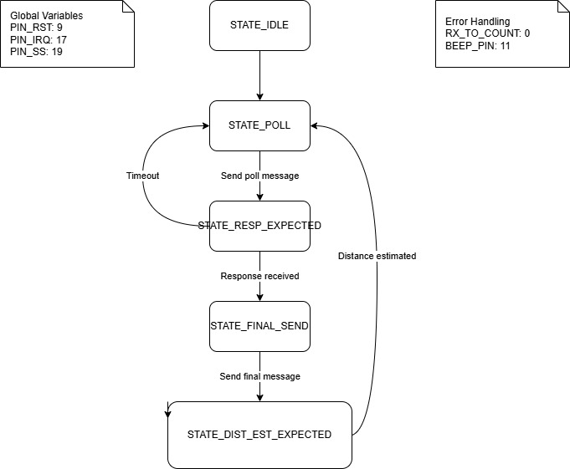
Implementation(Initiator)
State Machine Architecture:
STATE_POLL: Initiates ranging by broadcasting poll messages
STATE_RESP_EXPECTED: Waits for responses from responder devices
STATE_FINAL_SEND: Sends final timing information
STATE_DIST_EST_EXPECTED: Receives and processes distance estimates.
Key Features:
Two-Way Ranging (TWR) protocol implementation1
Automatic retry mechanism with configurable attempts
Distance threshold detection (triggers at <1000 units)
Dual broadcast ID system with automatic switching
Error Handling
Timeout detection and recovery
Error state logging
Automatic state recovery
RX timeout counter
Initiator

Slide 10
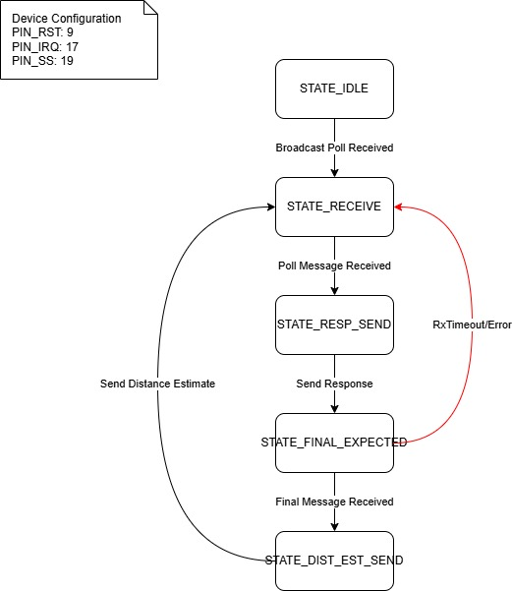
Implementation (Responder)
State Machine Architecture
STATE_RECEIVE: Initial listening state for poll messages
STATE_RESP_SEND: Sends response to initiator
STATE_FINAL_EXPECTED: Waits for final message
STATE_DIST_EST_SEND: Calculates and sends distance estimation
Key Features:
Two-Way Ranging (TWR) protocol implementation
Broadcast message handling
Multiple distance calculation methods:
Decawave formula (primary method)
Average TWR range
Simple ranging calculations
Error Handling:
Timeout management with automatic reset to receive state
Error recovery through state machine reset
RX timeout counter for tracking failed receptions
Responder

Slide 11
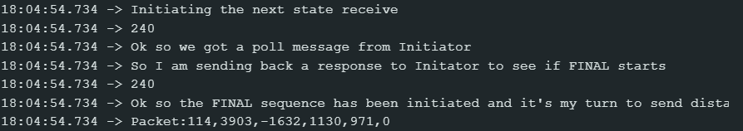
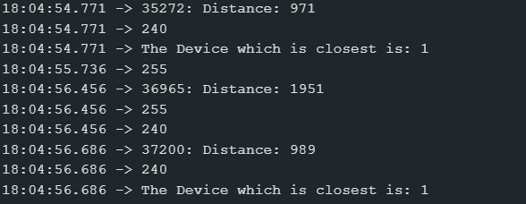
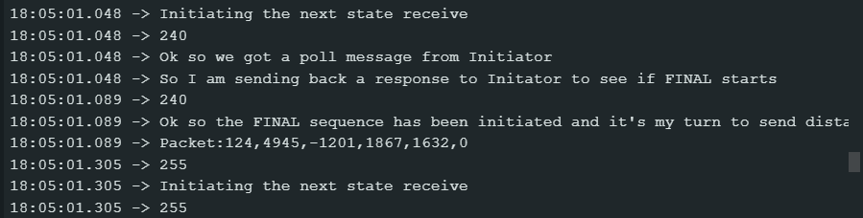
Results and Analysis
On the Initiator Side:
On the Responder Side

Slide 12
Demo

Slide 13
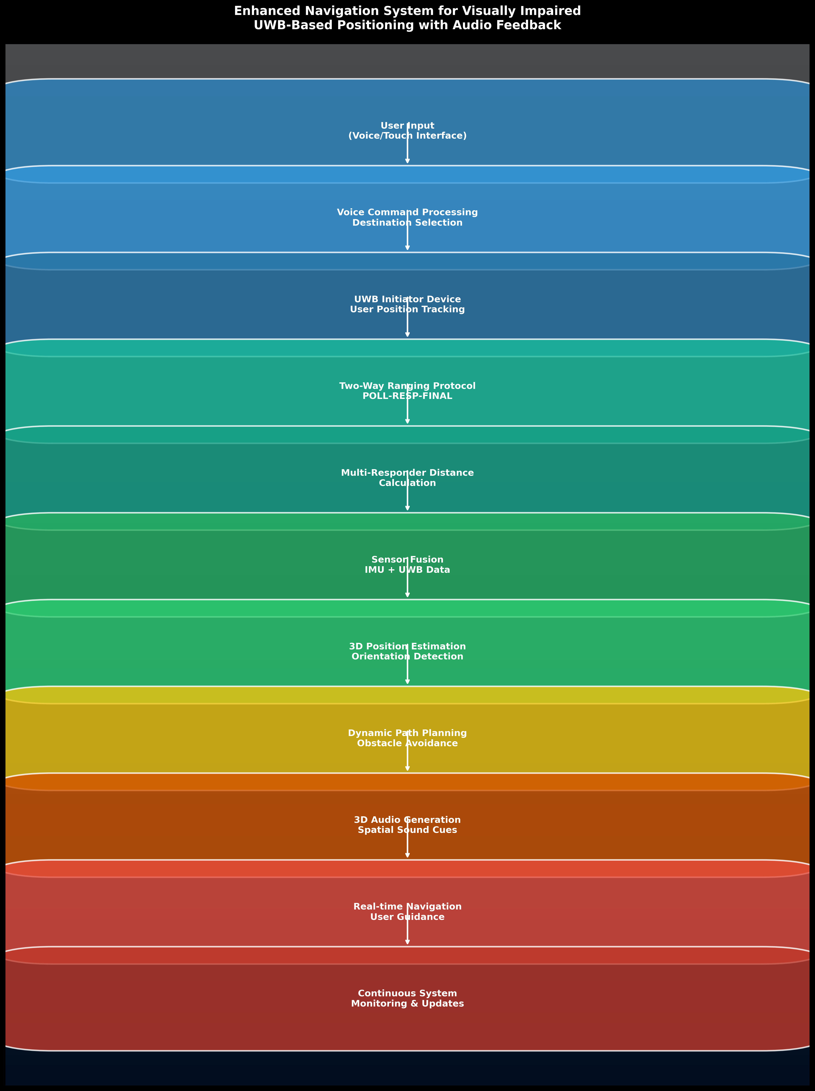
Future Work
Increase the number of responders in the set up, with a novel two way ranging protocol.
Implement audio-clip based mechanisms to play audio signals to guide visually impaired people to a destination responder.
Incorporate orientation of body to improve localization and navigation queues.
Ability for visually-impaired individual to mention destination, and audio signals transmitted to help navigate based on responder output.

Slide 14
Conclusion
The UWB-based audio guide system provides centimeter-level accuracy for indoor positioning, surpassing limitations of GPS, Wi-Fi, and Bluetooth-based solutions.
It enhances independence for visually impaired individuals by offering precise, location-specific audio cues for navigating complex indoor environments
The system utilizes a state machine architecture with robust error handling, ensuring reliable operation of both initiator and responder components
Designed to be adaptable and scalable, suitable for implementation across diverse environments such as museums, airports, and shopping malls
Future enhancements include multi-responder setups, audio-clip based guidance, and incorporation of body orientation for improved navigation

Slide 15
References
R. Öktem and E. Aydın, "An RFID-based indoor tracking method for navigating visually impaired people," Turkish Journal of Electrical Engineering and Computer Sciences, vol. 18, no. 2, Art. 4, 2010. [Online]. Available: https://doi.org/10.3906/elk-0904-3
C. Tsirmpas, A. Rompas, O. Fokou, and D. Koutsouris, "An indoor navigation system for visually impaired and elderly people based on Radio Frequency Identification (RFID)," Information Sciences, vol. 320, pp. 288-305, 2015. [Online]. Available: https://doi.org/10.1016/j.ins.2014.08.011.
https://www.mokoblue.com/ble-vs-rfid-vs-uwb-what-are-the-differences/# : differences between Bluetooth, UWB, and RFID image.
A. Dhekne, A. Chakraborty, K. Sundaresan, and S. Rangarajan, "TrackIO: Tracking First Responders Inside-Out," in Proc. 16th USENIX Symp. Networked Systems Design and Implementation (NSDI '19), Boston, MA, USA, Feb. 2019, pp. 751–764. [Online]. Available: https://www.usenix.org/conference/nsdi19/presentation/dhekne.
Laadung, Taavi & Ulp, Sander & Alam, Muhammad & Le Moullec, Yannick. (2020). Active-Passive Two-Way Ranging Using UWB.
Hudha Wijaya, Nur & Ibrahim, Miftah & Shahu, Nishith & Sattar, Mian. (2021). Arduino-based Digital Advanced Audiometer. Journal of Robotics and Control (JRC). 2. 10.18196/jrc.2257.

Slide 16
Questions?

